Slide 1
West End Service, Inc.
Sales Team Demo Presentation:
2022 International MV Chassis onsite at Miller Industries Towing Equipment plant facility, Ooltewah, TN.

Slide 2
2022 International MV607
Our salesman, John Klein, Jr. shows customer interior of cab. Stating standard options available with current year and model.

Slide 3
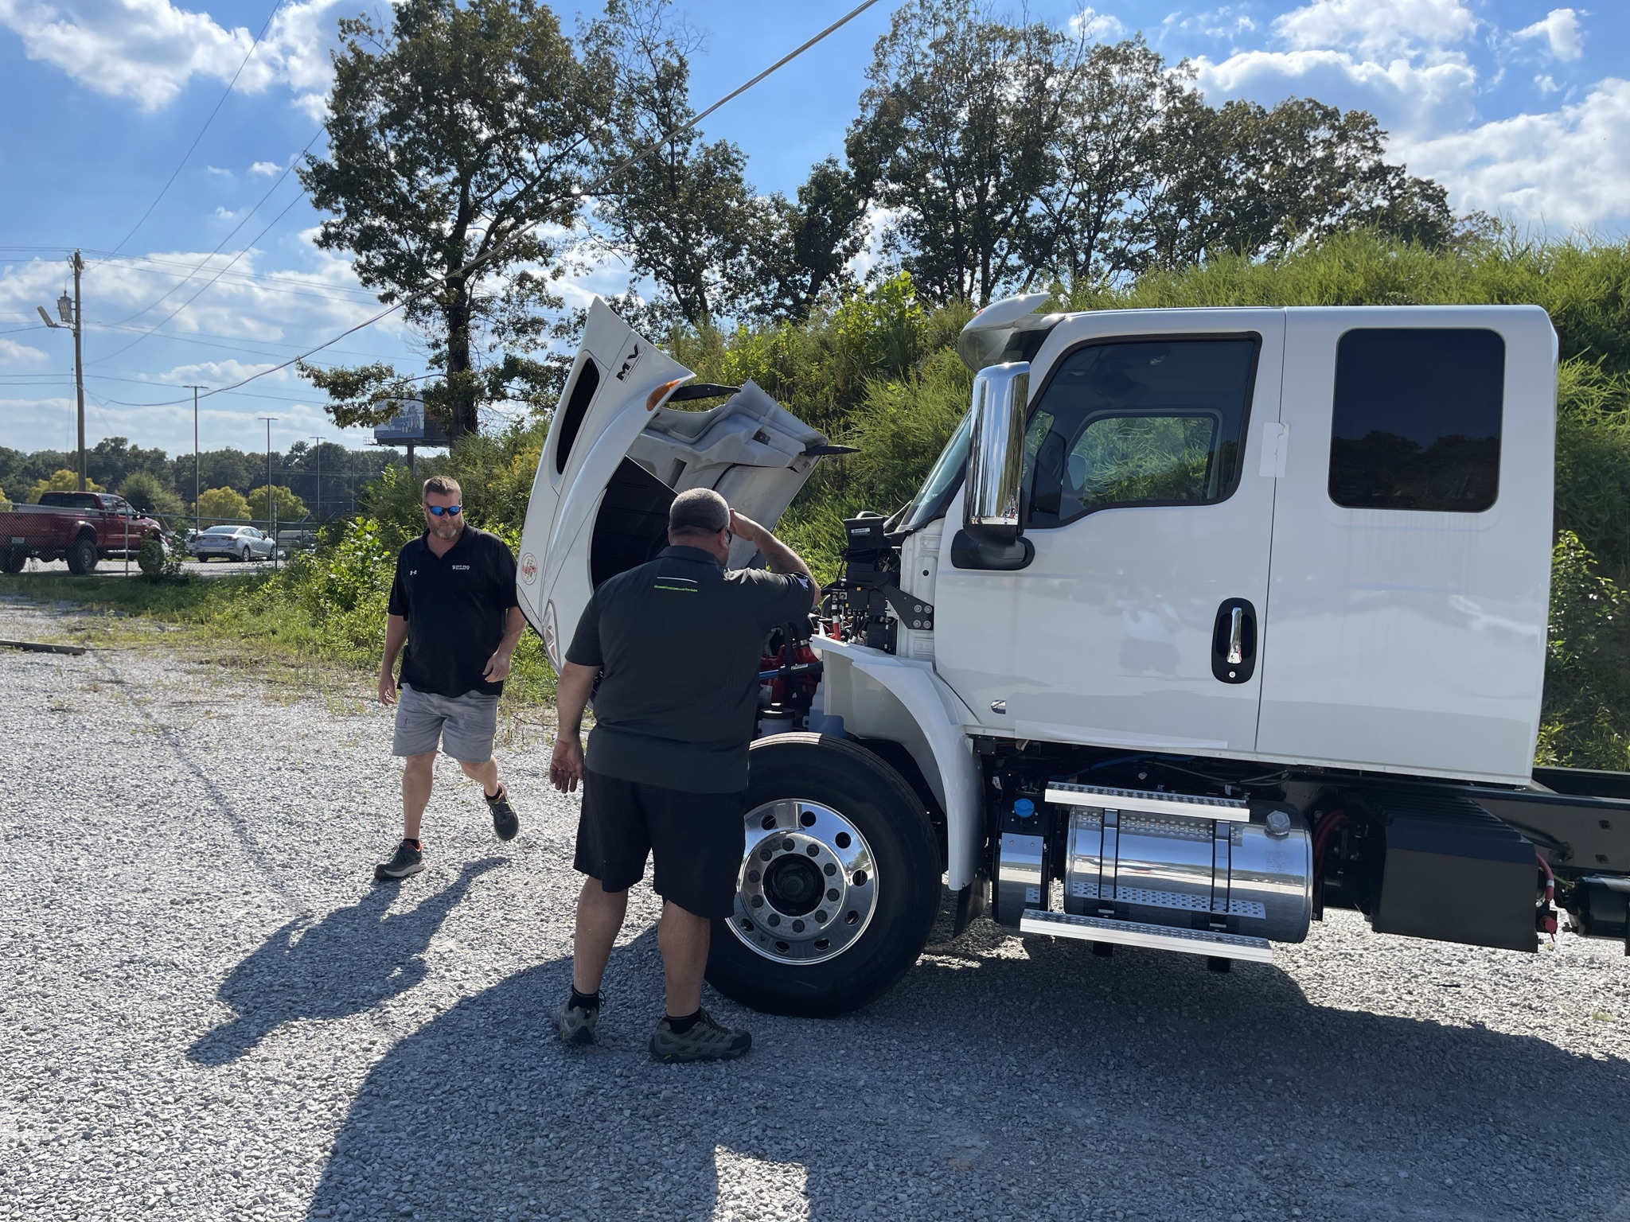
Pedestal Mirrors make visibility better for drivers, and breakaway design mirrors to prevent damage.
Polished Aluminum Wheels & Tanks

Slide 4
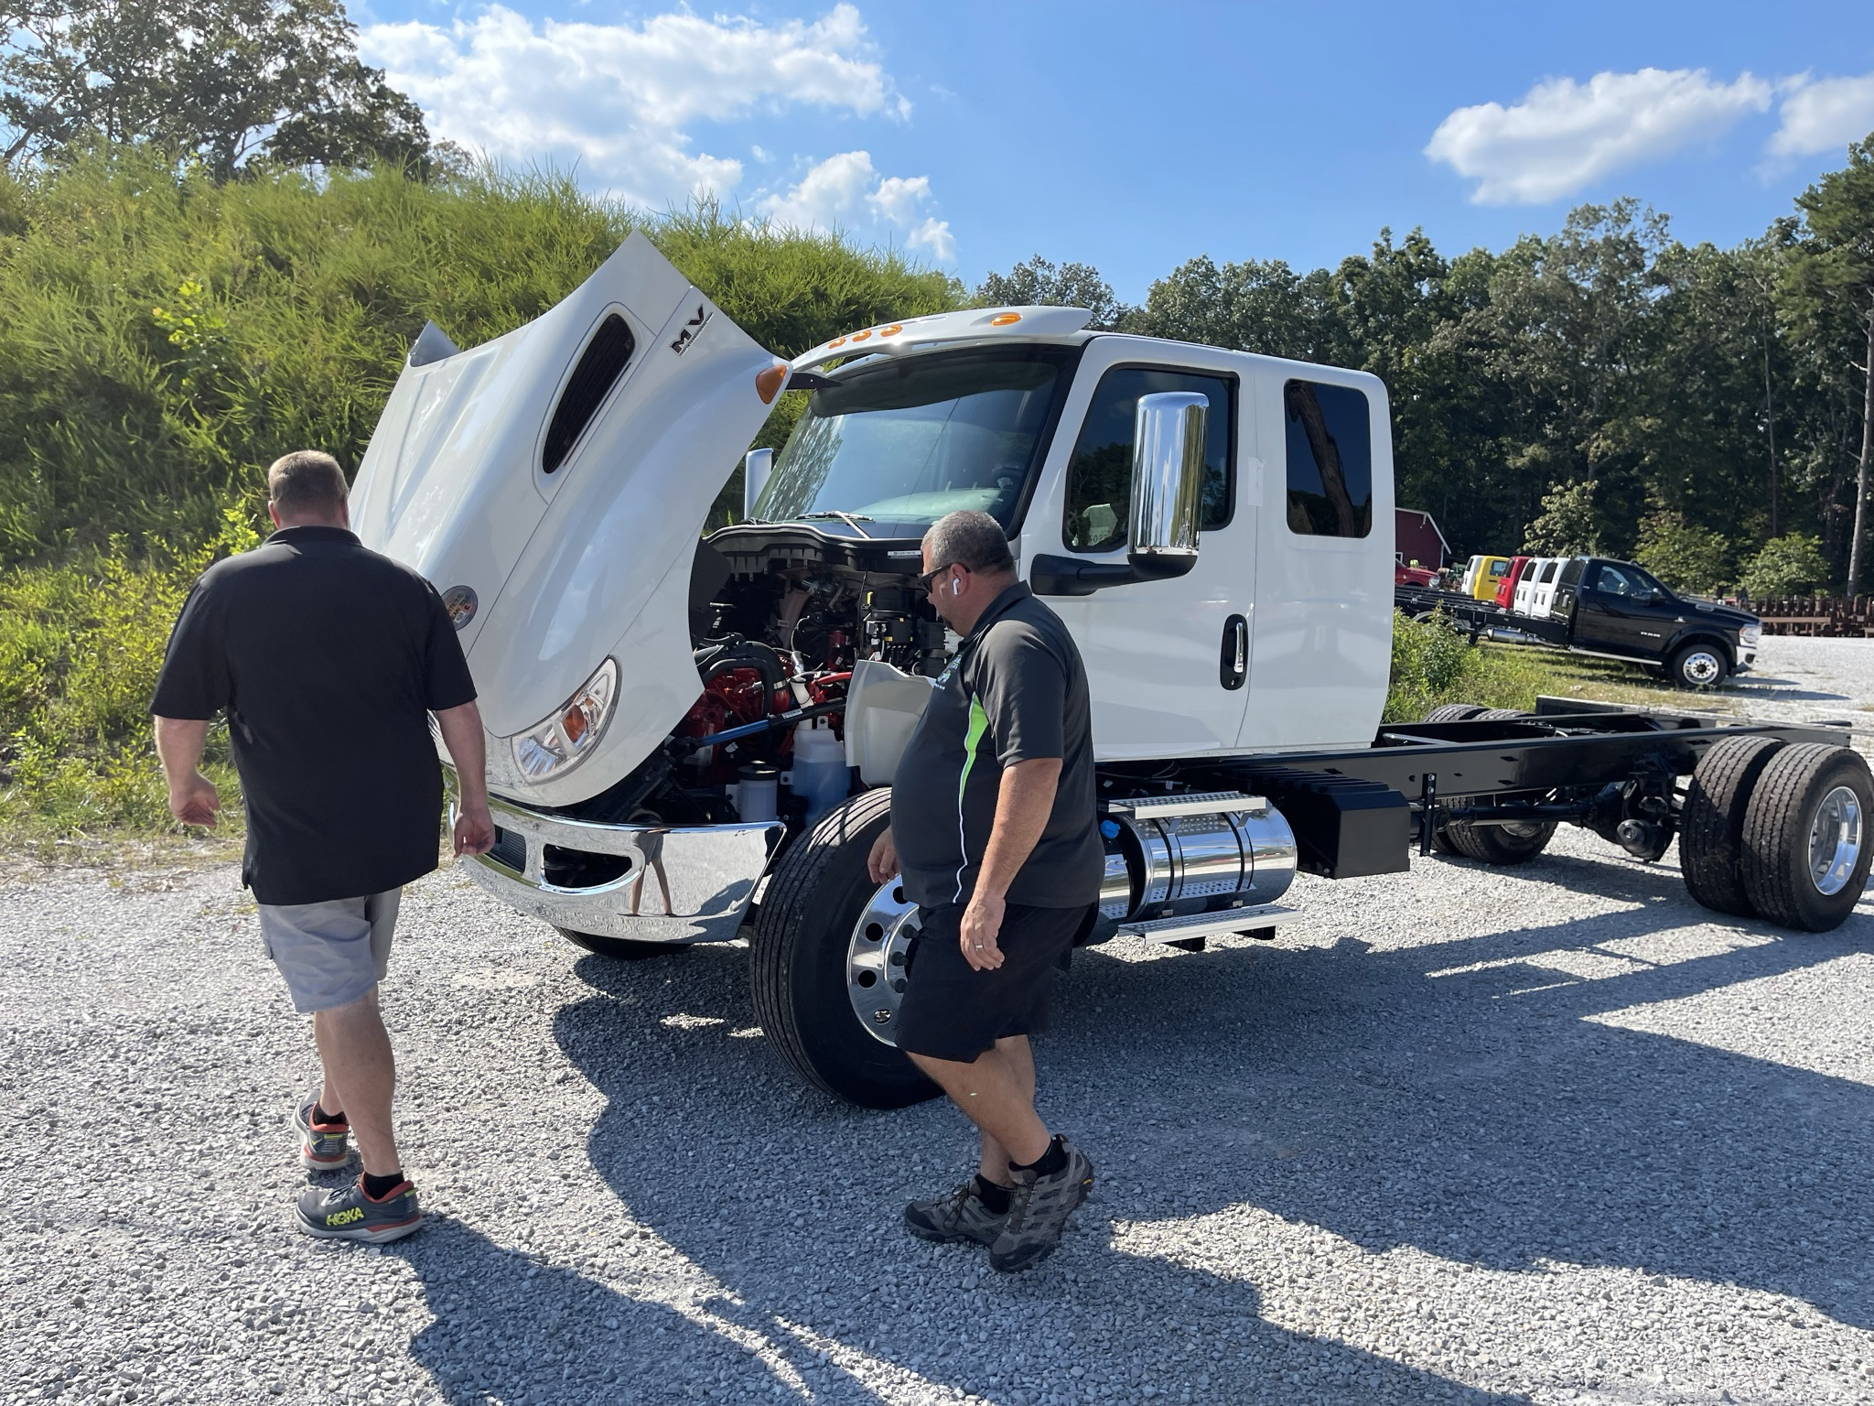
ENGINE DETAILS: CUMMINS B 6.7 L Diesel Engine, Optional Exhaust brake, Extended Cab. Standard Warranty is 2 years / unlimited mileage. Numerous options for extendable coverage
Three part hood allowing for accessible engine repairs

Slide 5
Completed all pertinent selling points for the 2022 International MV607 chassis.
Looking forward to an order soon.

